Slide 1
Solar cell efficiency

Slide 2
第三章 半导体带间光吸收
Interband absorption
The transition rate for direct absorption
Band edge absorption for direct band gap
Band edge absorption for indirect band gap
Absorption beyond band gap
Absorption measurement at different conditions
Photodetectors & solar cells
Notes:
章节结构：fundamental-> device；(interband) absorption->photodector and solar cell.
Fundamental: rate -> direct gap; indirect gap; absorption beyond band gap→measurement at different conditions (ltuning);

Slide 3
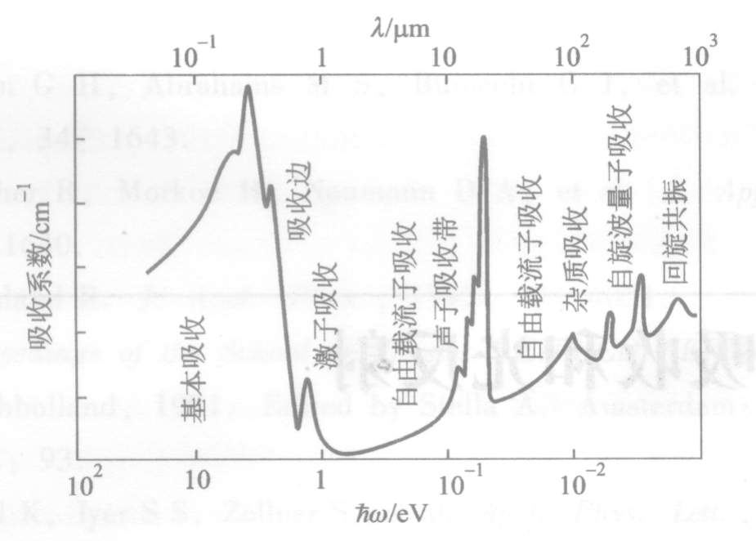
Interband absorption
光吸收系数:

Slide 4
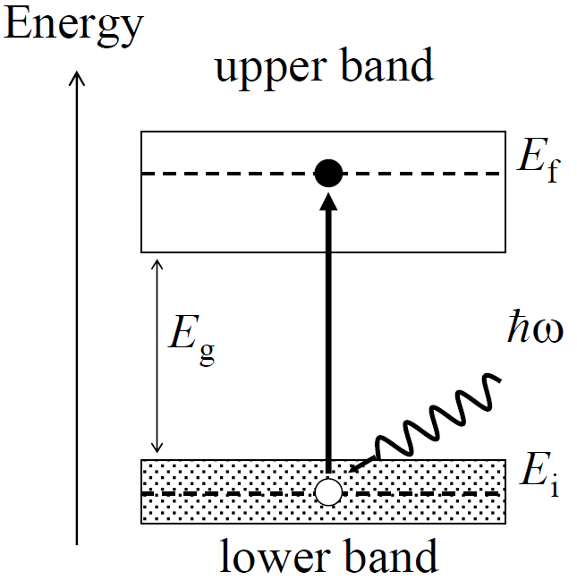
Interband absorption
• Photon excites electron
from filled valence to empty conduction band
• Fundamental
absorption edge at E_{g}
• Process creates an
electron–hole pair
●
●●

Slide 5
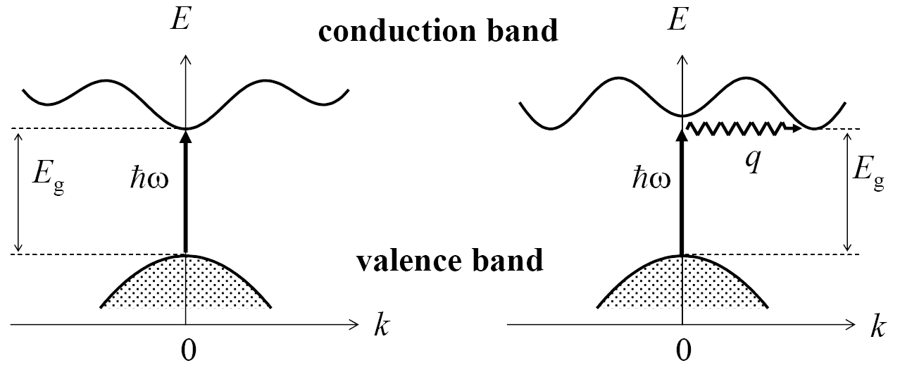
Direct absorption
C.B. minimum
at k = 0
• k_{photon} = 2π/λ ~ 10⁷ m^{–1} negligible compared to B.Z. size π/a ~ 10¹¹ m^{–1}
• Transitions appear as vertical lines on E – k diagrams for direct band gap
• Phonon needed to conserve momentum for indirect gap materials, therefore low probability

Slide 6
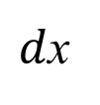
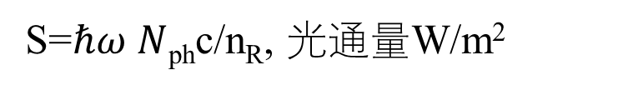
吸收系数与跃迁速率
S
Light
$d$x
S=$ℏω N$_{ph}c/n_{R}, 光通量W/m²
w_{i-j}: 跃迁速率
参考 叶良修，半导体物理（上）P506
Notes:
跃迁速率：单位体积单位时间吸收跃迁的次数（几率和）,

Slide 7
Direct transition rate
Fermi’s golden rule
空间部分
少了啥？
附录1
Notes:
Fermi’s golden rule：0→t 时间内,常微扰或周期微扰，t 足够长，周期微扰使得跃迁矩阵元中的不含时间部分，平均的后果，故，是单位时间的跃迁数，就跃迁（速）率。
单位时间，单位体积的跃迁几率－速率
Semi-classical：
Wavevector conservation ; “vertical transitions”

Slide 8
Absorption @ direct band edge
含宇称等选择定则
Joint DOS
附录2
Notes:
Absorption spectra characteristics：Strong; Continuous; Broad

Slide 9
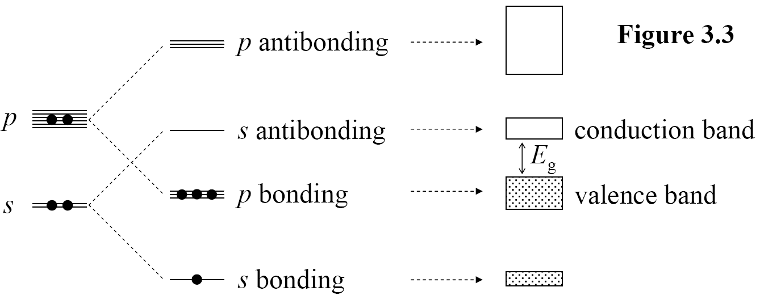
Atomic physics of semiconductors
Ge: 4s²4p²
• Four valence electrons per atom: Group IV (C, Si, Ge),
• III-V compounds (GaAs, InAs, InSb, InP, GaN ….)
• II-VI compounds (ZnS, ZnSe, CdSe, HgTe, …. )
• V.B. → C.B. is p → s, hence allowed transition
Si: 3s²3p²
sp hybridization
选择定则

Slide 10
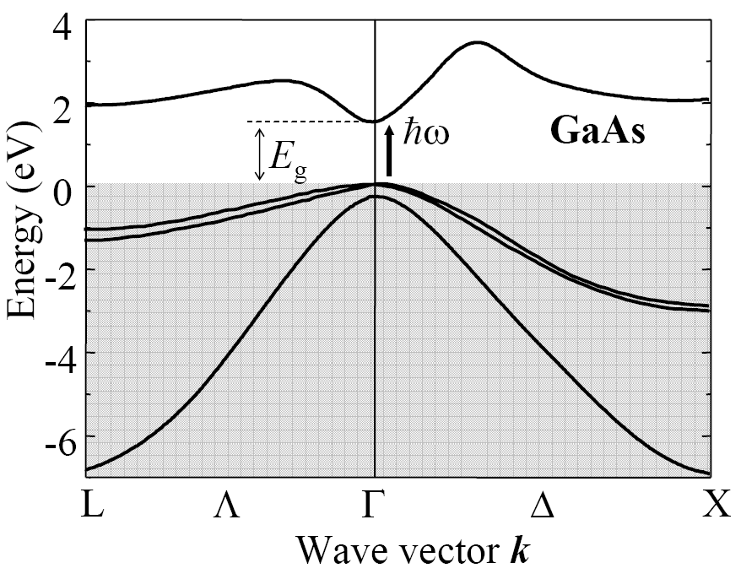
GaAs band structure
• Direct gap at 1.5 eV (0 K)
• Very important
optoelectronic material
• Strong absorption for ħω > E_{g}
fcc lattice Brillouin zone
Symmetry points
Γ 000
X 100
010
001
K 110
L 111
Camel back; X valley

Slide 11
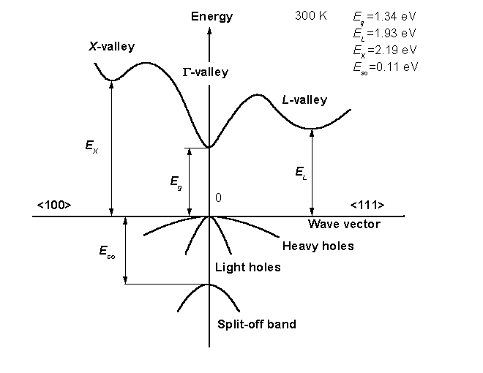
InP band structure
Long wavelength laser material
Direct gap @
E_{g}=1.34 eV
http://www.ioffe.ru/SVA/NSM/Semicond/InP/bandstr.html

Slide 12
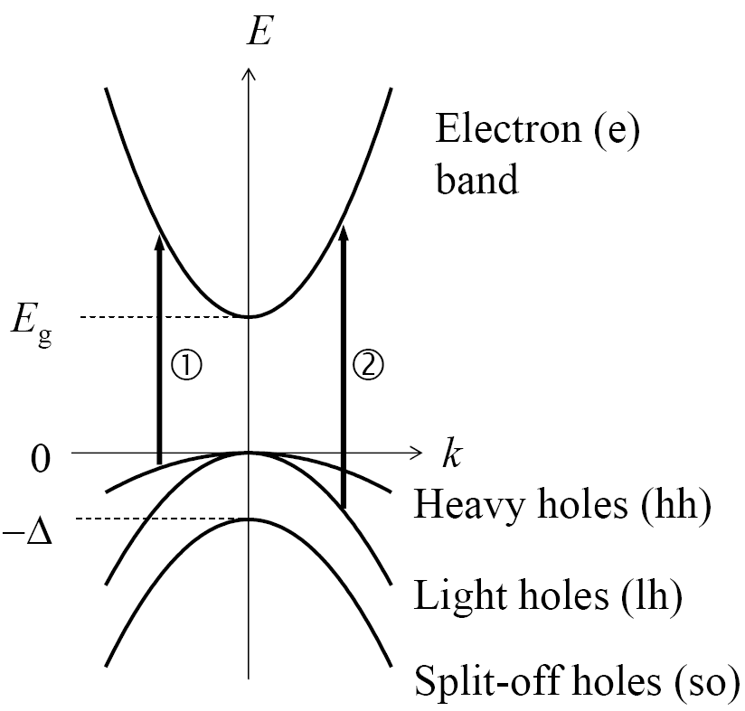
Four-band model
• Simplified band
•Parabolic appr. E~k
valid near k = 0
• Split-off hole
transitions also possible
Notes:
structure first proposed by Kane (1957)

Slide 13
Examples for direct band edge absorption
(a) InSb at 5 K
(b) GaAs at 300 K
deviations from e.g. due to phonon absorption or non-parabolicity of the bands

Slide 14
Indirect absorption
• Phonon needed to conserve momentum for indirect gap materials, therefore low probability: k_{f}=k_{i}+k_{phtn}±q
Wavevector conservation

Slide 15
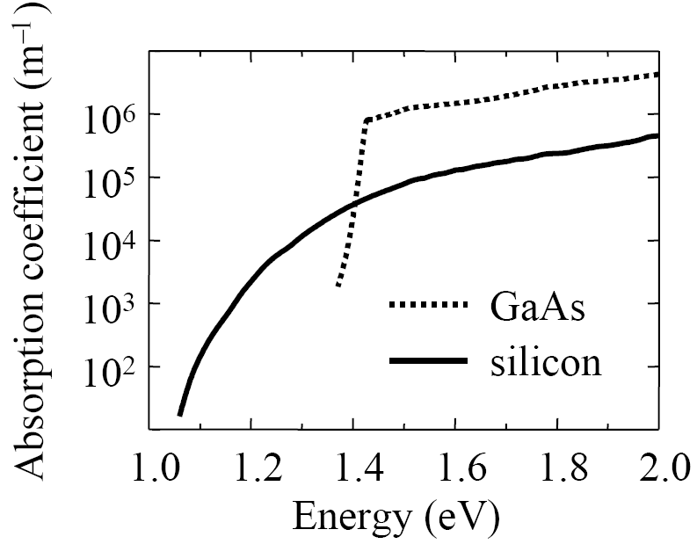
Direct versus indirect absorption
• Direct absorption is
much stronger than
indirect absorption
•Silicon has indirect gap at 1.1 eV
• GaAs has direct gap at
1.4 eV
Edge absorption tells..

Slide 16
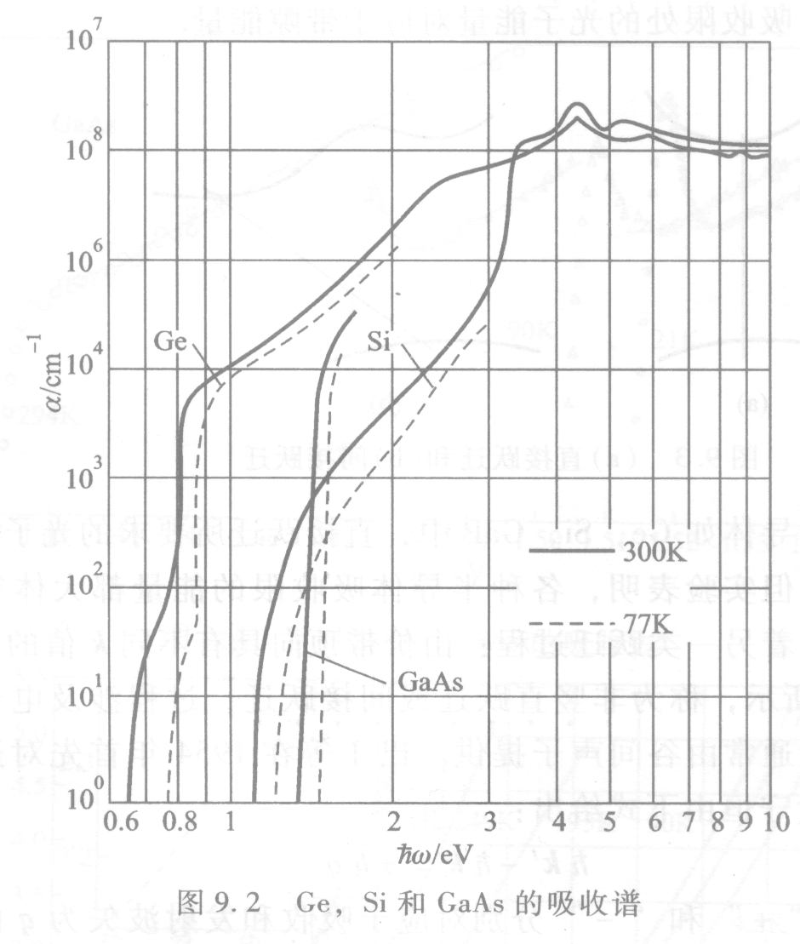
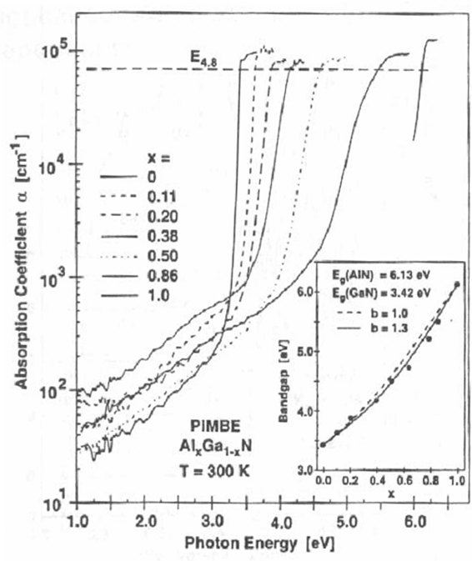
Edge absorption tells..
Ge, Si, GaAs, AlGaN基本吸收

Slide 17
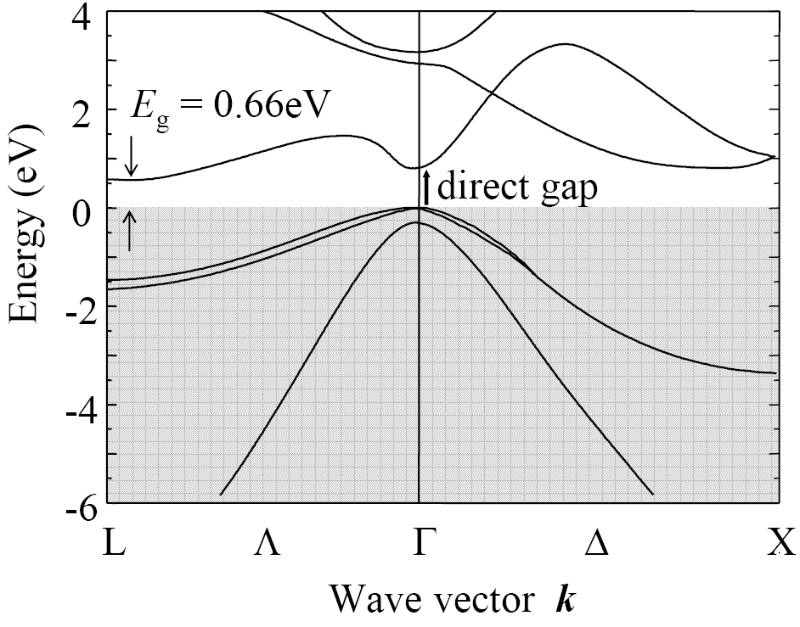
Germanium band structure
• Indirect gap
at 0.66 eV
• Direct gap
at 0.80 eV

Slide 18
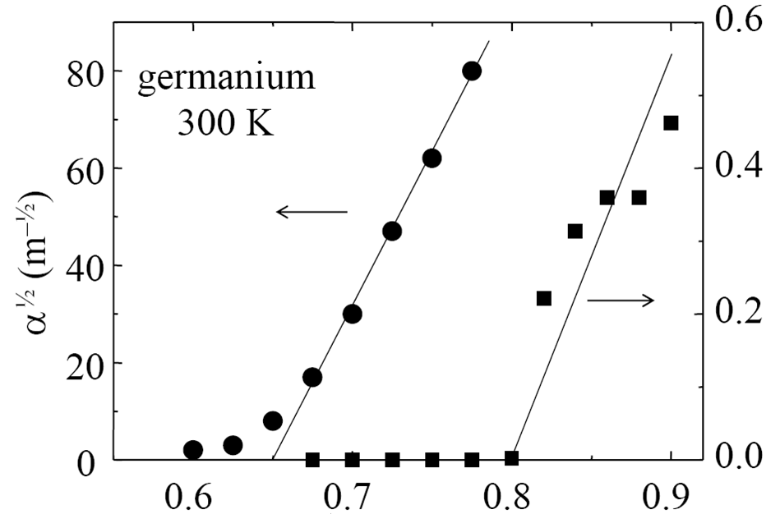
Germanium band edge absorption
E_{g}^{ind} = 0.66 eV
E_{g}^{dir} = 0.80 eV
Application !!
α² (10¹² m⁻²)
• indirect absorption: α ∝ (ħω – E_{g}^{ind} ± ħΩ_{phonon} )²
• direct absorption: α ∝ (ħω – E_{g}^{dir} )^{½}
Notes:
Ge: 吸收特别处：两个带边离不远

Slide 19
随堂练习
Exercise 3.7 (p93)
Use the data given in Fig.3.11 (p81) to estimate the absorption coefficient of Ge at 1200 nm at room temperature.

Slide 20
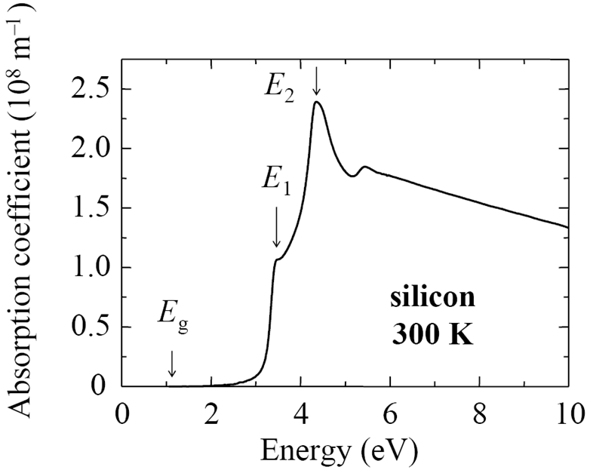
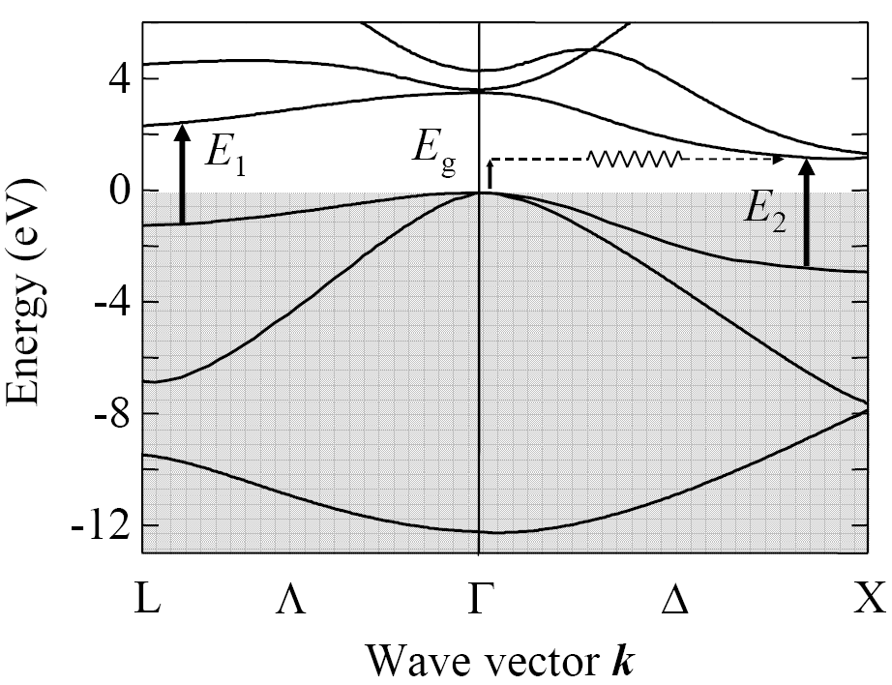
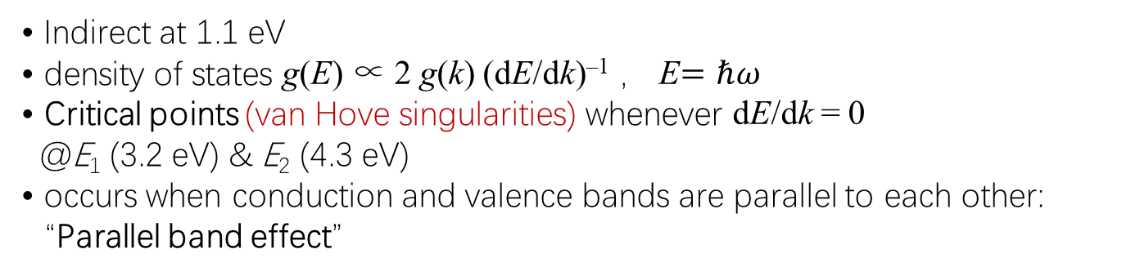
Silicon absorption above band edge
Silicon band structure
• Indirect at 1.1 eV
• density of states g(E) ∝ 2 g(k) (dE/dk)^{–1} ， E$=ℏω$
• Critical points (van Hove singularities) whenever dE/dk = 0
@E₁ (3.2 eV) & E₂ (4.3 eV)
• occurs when conduction and valence bands are parallel to each other: “Parallel band effect”
Notes:
4 带边以上的吸收 MIT P28, 黄昆 P215
dE/dk=0→ DOS=g(k)/(dE/dK)→ ∞
20

Slide 21
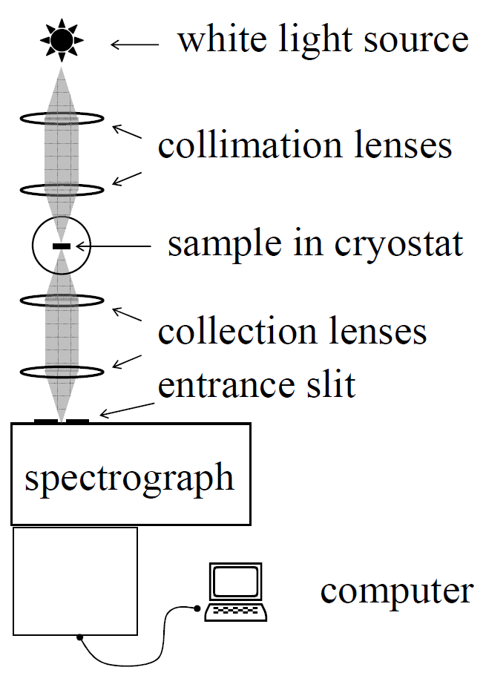
Absorption spectroscopy measurement
Measure transmission coefficient;
2. Measure reflectivity spectra R (ħω)
Si arrayed
detectors
measurements@ different E, B, T, Pl, l:
Notes:
Self-consistent fitting of the reflectivity spectra using the Kramers-Kronig formula.

Slide 22
The Franz-Keldysh effect
Two main effects on band edge absorption by application of an external electric field E（note）
Electro-optic effect
The electric field modulated optical constants (n,κ).
(K-K relationship).
Electroreflectance
The reflectivity can be changed due to modulated optical constants (n,κ).
测量条件对吸收的影响
Notes:
German physicist Walter Franz and Russian physicist Leonid Keldysh 1958；Germany; Ruassian

Slide 23
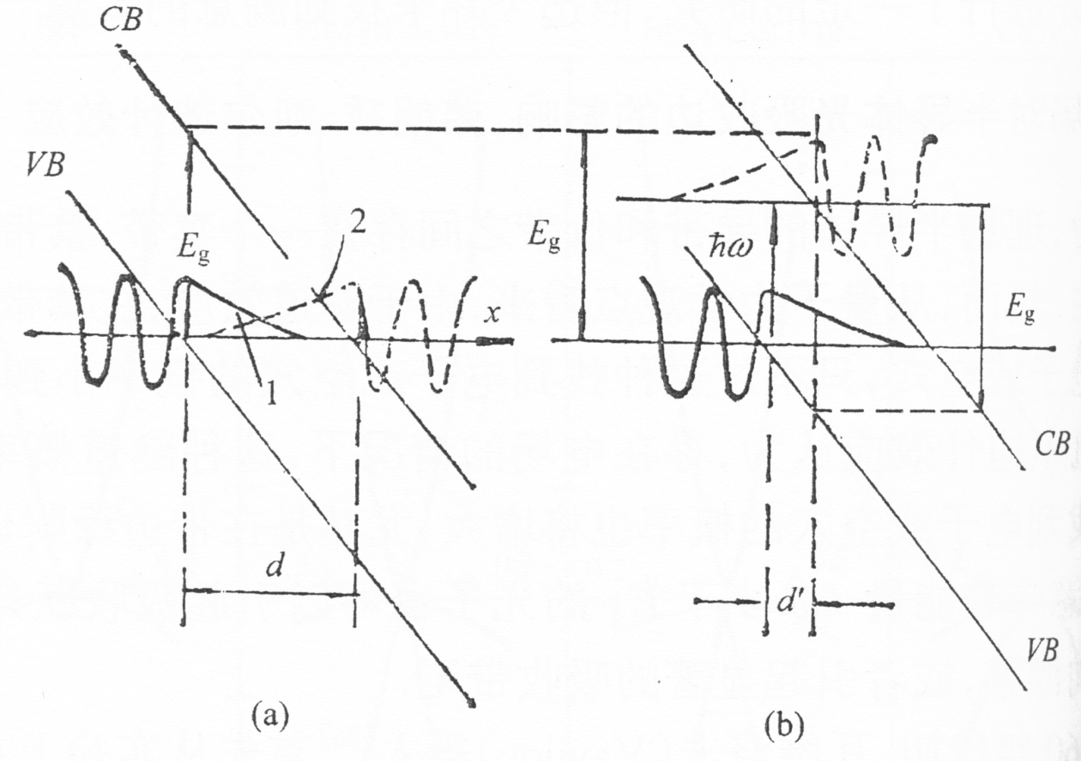
Band in a strong electric field
For the Franz-Keldysh effect

Slide 24
Example for the Franz-Keldysh effect
R. Williams Physics Rev. 117, 1487 (1960)

Slide 25
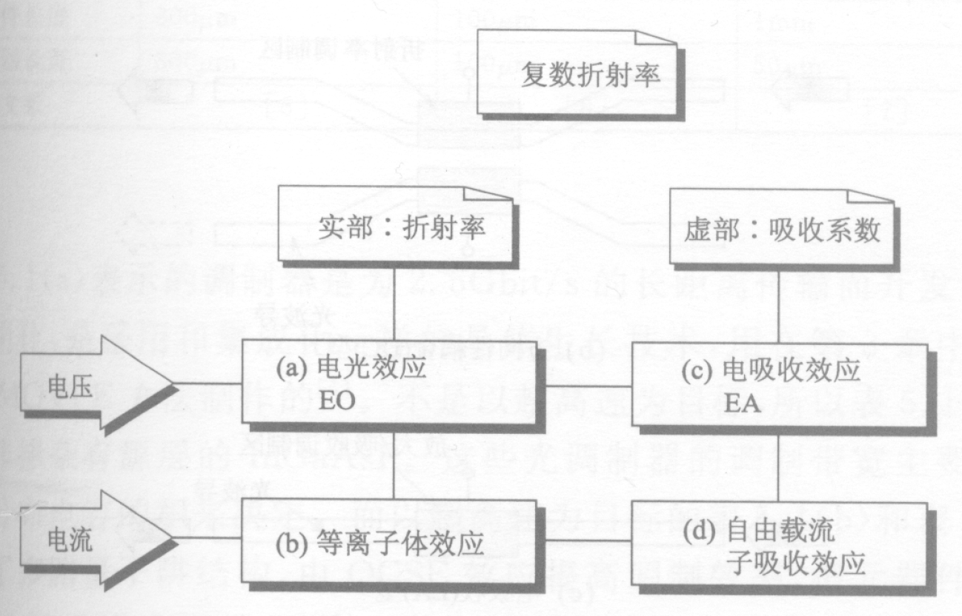
Modulator principles
Electro-Optical
Pokels, Kerr
Franz-Keldysh

Slide 26
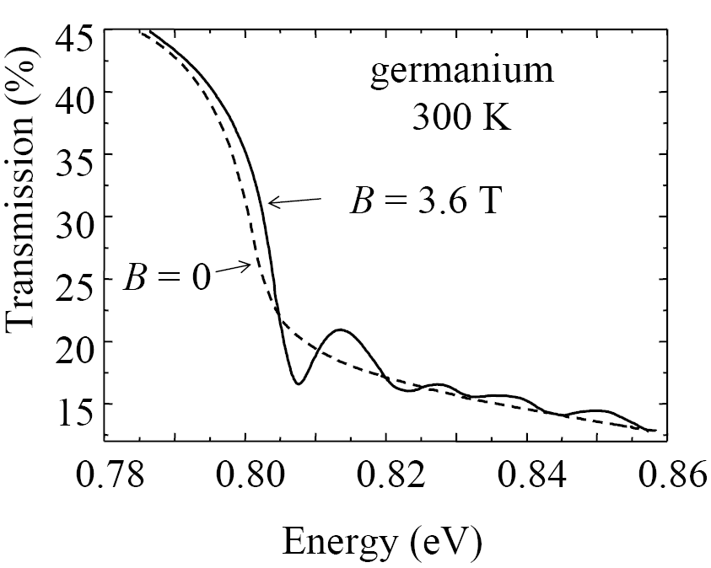
Magneto absorption in germanium
• direct gap at 0.80 eV
• B-Field quantizes motion in direction perpendicular to B
• Landau level absorption
when
ħω = E_{g} + (n+½) ħ ω_{c}
ω_{c} = eB / m_{e}
(cyclotron frequency)
Two consequences:
The absorption edge shifts by heB_{Z}/2μ;
Equally spaced peaks in the spectrum.

Slide 27
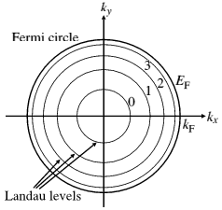
Landau level
Suppose B direct is along z
Classic:
ω = eB/m₀
B
Quantum:
ħω = E_{g} + (n+½) ħ ω_{c}

Slide 28
Spin injection in quantum wells
Selection rules
σ+: Δm = +1
σ−: Δm = −1
No crossing
LS 耦合跃迁Selection rules：
ΔS = 0; ΔL = 0,±1; ΔJ = 0,±1; (J=0→J=0 除外)

Slide 29
Spin injection in quantum wells
The parity different.
Δ j = 0 ，±1 (Total angular momentum).
Δ l = ± 1.
Δ m_{s} = 0. (Spin quantum numbers never change).
Electric-dipole transition: high transition rate, short radiative lifetime(10⁻⁹– 10⁻⁸ s)

Slide 30
(Heavily) Doping
Burstein-Moss
Effect

Slide 31
Photodetectors
Quantum Efficiency
Responsibility A/W
Response time
Direct bandgap
Reverse bias
Noise
E_{g,} T…
Photoconductive Mode; Photovoltaic Mode

Slide 32
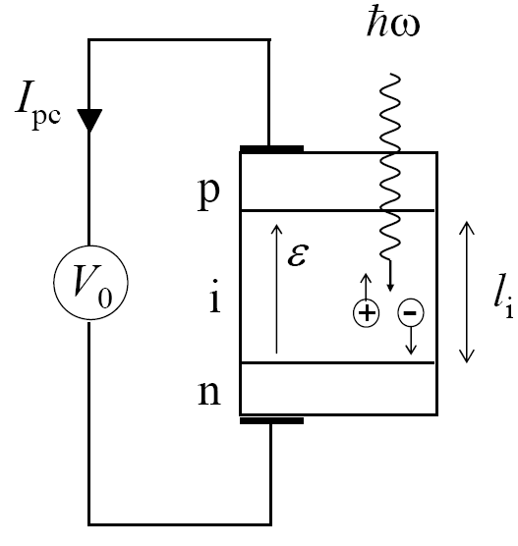
Photodetectors
ħω > E_{g}
• Embed absorbing region within
p-n junction to form p-i-n diode
• Apply reverse bias V₀
• Electric field ε = (V_{bi} – V₀) / l_{i}
• V_{bi} = built-in voltage ≈ E_{g} / e
• Photons absorbed creates e-h pairs in i-region
• Carriers swept out by ε field
into external circuit to generate
photocurrent I_{pc}
Examples:
• photodiodes
• solar cells (V₀ = 0)

Slide 33
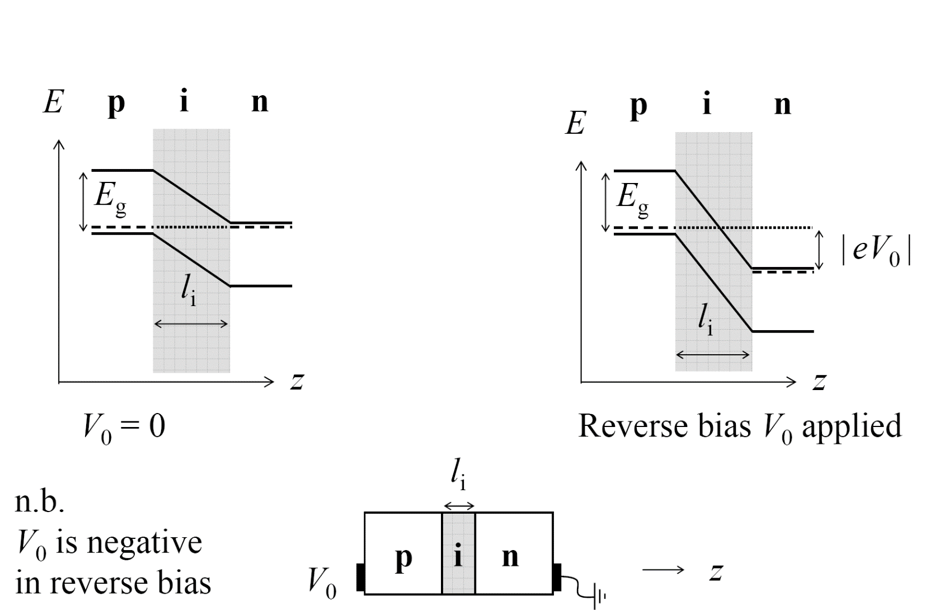
p-i-n diodes

Slide 34
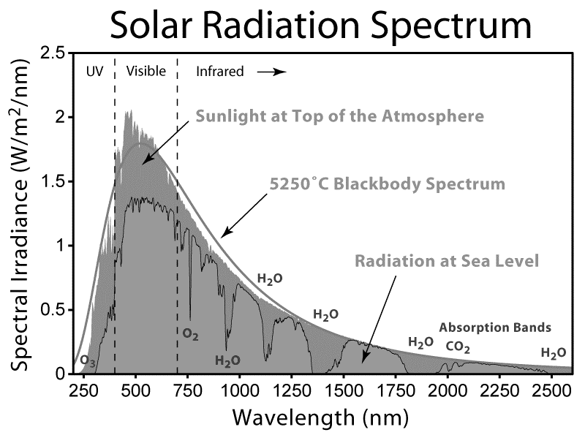
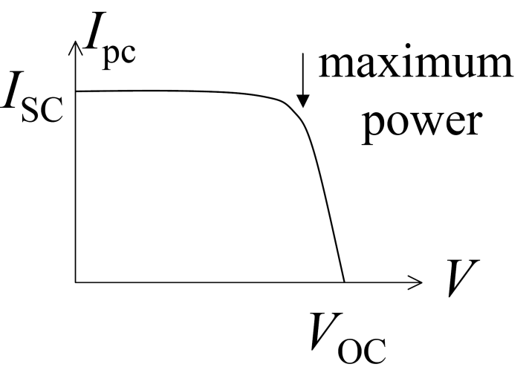
Solar cells (photovoltaics)
• Small gap: large I_{SC} , small V_{OC}
• Large gap: small I_{SC} , large V_{OC}
• Single junction: max efficiency ~30%
• Larger for multi junction

Slide 35
课后作业
Exercise (选作)
By referring the figure for the spin injection, prove that the rate for the HH-CB transitions is 3 time as large as that for LH-CB transitions with σ+ light illumination.
Note: Transition matrix element M=<J-1, M_{J}+1| σ+ | J, M_{J} >
HH: heavy hole; LH： light hole; CB： conduction band

Slide 36
微扰矩阵元
附录1
含时微扰的波函的展开系数的一般形式，微分积分方程－精确
含时微扰矩阵元
一级近似，
设上式 a_{n}(t)=δ_{nm}
t 时刻 出现在m态的几率
（平均）跃迁速率

Slide 37
Fermi’s golden rule
附录1
单位时间，单位体积的跃迁几率－速率
0→t 时间内,常微扰或周期微扰，t 足够长。
空间部分, 注意,有的书上是H′/2
量子力学教科书

Slide 38
附录1：含时微扰
一个电子（系统）在电磁场中
空间部分，微扰部分
无微扰
两侧左乘ϕ_{m}*(r,t), 并空间积分；
零级波函项左右相抵后：

Slide 39
光场微扰算符的形式
附录1
电子在电磁场中，非保守力场，用矢势
p为动量算符-iħ∇ A为电磁场矢势
q 为基本电荷
略去A²项；A，P对易；与无场时的电子能量比较可得微扰。
A与E的关系：
A的具体形式？
半经典理论

Slide 40
跃迁动量矩阵元
附录1
设微扰是简谐的。
e 矢势单位矢；k_{p} 光波矢 .
略去了光子波矢项
跃迁动量矩阵元
（Vs 偶极跃迁矩阵元）

Slide 41
跃迁动量矩阵元VS偶极跃迁
附录1
(Dirac ) Interaction picture
*
note
* Fox, P346; 量子力学,曾谨言 4th ed, P165

Slide 42
跃迁动量矩阵元VS偶极跃迁
附录1
e 矢势单位矢, A₀常数
E₀电场幅值
p_{e} 电子电偶极

Slide 43
偶极跃迁矩阵元
附录1
Perturbation:
Dipole moment:
Light wave:
The electron state wave function:
Initial:
Final:
M. Fox, 固体光学性质p52

Slide 44
吸收系数的一般形式
附录2
Light
dx
S, 光通量, 入射到单位面积上的光功率,坡因廷矢量的大小
W_{fi}: 单位体积内单位时间内吸收的入射光子数, 即单位体积吸收入射光的速率
参考 叶良修，半导体物理（上）P506

Slide 45
吸收系数的一般形式的推导
设光场的矢势为A
矢势表示的poynting 矢量:
推导：曾谨言 量子力学 第四版 II，P431
至此, 只须求出W_{fi}，即H’_{fi}

Slide 46
直接禁带
附录2
跃迁动量矩阵元
动量守恒

Slide 47
直接禁带基本吸收边
附录2
联合态密度:能量守恒+动量守恒
此处的状态数为g_{CV}（ħ ω）:
知能带，可求之

Slide 48
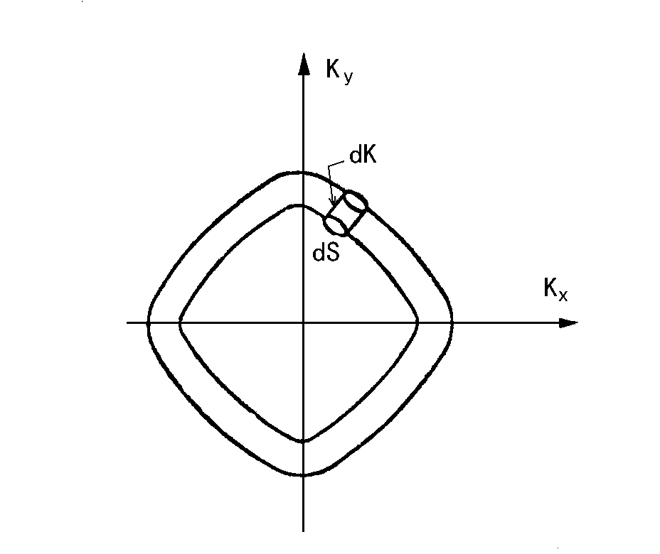
态密度函数
附录2
定义：
。。。。。。。。。。。
。。。。。。。。。。。
。。。。。。。。。。。
。。。。。。。。。。。
。。。。。。。。。。。
。。。。。。。。。。。
。。。。。。。。。。。
。。。。。。。。。。。
。。。。。。。。。。。
。。。。。。。。。。。
取决与E(K )关系，对于自由电子
Notes:
48
注：关于态密度的几个关系
m为实空间维度数
V为实空间体积

Slide 49
联合态密度
附录2
抛物线假设:

Slide 50
简约态密度
附录2
美国黑书

Slide 51
直接禁带边吸收系数
附录2

Slide 52
直接禁带基本吸收边
附录2
分别考虑
容许直接跃迁（项）
禁戒直接跃迁（项）

Slide 53
容许直接禁带跃迁情形
附录2
取m_{r}/m₀=0.06
ε=0.2 eV
f_{CV}=1
n_{R}=4
得α=1.2x10³ cm⁻¹

Slide 54
禁戒直接禁带跃迁情形
附录2
因为k 平方项就是动能项(抛物线假设)

